Slide 1
Haryana election data analysis 2018
Kaithal District (Guhla, Kalayat, Kaithal)
By Pranjal Rastogi

Slide 2
Introduction
Haryana is a state in northern part of the Republic of India. Kurukshetra is one of 10 Lok Sabha constituency in Haryana
The Vidhan Sabha, the Legislative Assembly is the lower house of the state legislature in the different states of India.
Kurukshetra comprises nine Vidhan Sabha constituencies. This constituency covers the entire Kurukshetra and Kaithal districts and part of Yamunanagar district.
The analysis has been done for Guhla, Kaithal, Kalayat Vidhan Sabha constituencies in Kaithal District.

Slide 3
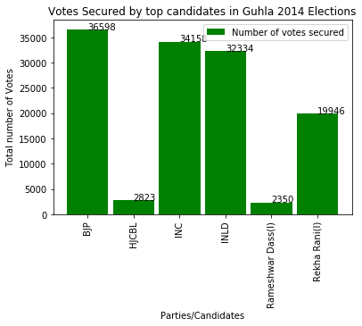
Elections were held just after Lok Sabha Elections in which BJP won clearly under leadership of Shri Narendra Modi. It's effect can be seen clearly in these elections as BJP clinched the victory. Even Though INLD and INC have strong roots here and managed to get substantial number of votes, but the effect of Lok Sabha elections helped BJP to clinch victory. The Margin was not so much with a mere difference of 4000 votes among top 3 parties.

Slide 4
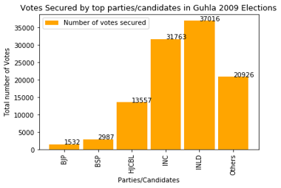
Elections were held just after Lok Sabha Elections,2009 in which INC formed alliance and restored power. INLD and INC have strong roots and voters base here and managed to get substantial number of votes. More than 50% votes have been clinched by these 2 parties. Others also got many votes showing that no other candidate has strong influence here. The Margin was not so much with a mere difference of 5000 votes between top 2 parties.

Slide 5
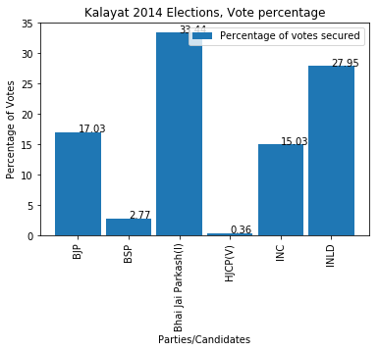
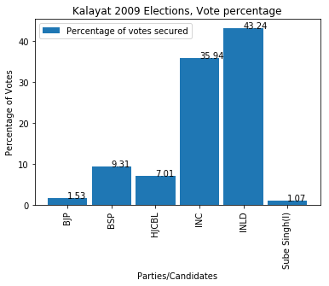
Elections were held just after Lok Sabha Elections. Bhai Jai Prakash won 2014 elections but did not contested 2009 elections showing his strong leadership .INLD and INC have strong roots here and managed to get substantial number of votes, which account for more than 50%. No other candidate was able to get substantial votes.

Slide 6
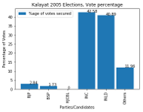
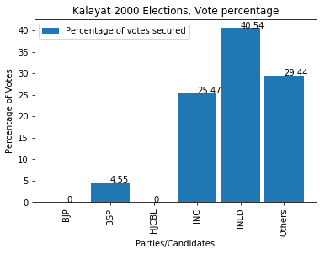
Elections were held just after Lok Sabha Elections. INC won 2005 elections and INLD won 2000 elections showing their strong leadership .INLD and INC have strong roots here and managed to get substantial number of votes, which account for more than 50%. No other candidate was able to get substantial votes. But others got high number of vote percentage in 2000, showing that besides INLD no other party had strong base there.

Slide 7
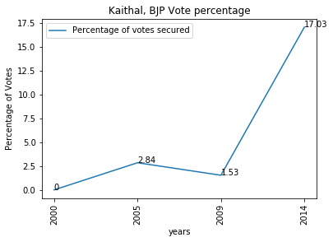
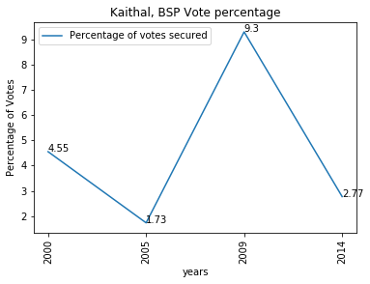
BJP vote percentage pattern shows that BJP didn't have strong influence their but in 2014 because of strong wave for BJP among people, they managed to secure 17% of votes. BSP on other hand has similar pattern securing between 1-4 %votes with an exception in 2009

Slide 8
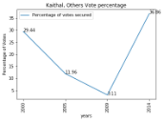
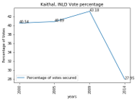
INLD vote percentage pattern shows that they have strong influence and managed to get around 40% of votes each time but in 2014 because of strong wave for BJP among people, they managed to secure only 27% of votes. Others on other hand have varying pattern securing from29 and 36 %votes to mere 5% in 2009.

Slide 9
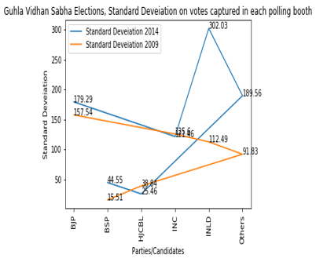
A low standard deviation indicates that the data points tend to be close to the mean of the set, while a high standard deviation indicates that the data points are spread out over a wider range of values. INLD in 2014 has an exceptionally high standard deviation while BSP has low standard deviation comparatively. Rest have intermediate standard deviation in between 100-150.

Slide 10
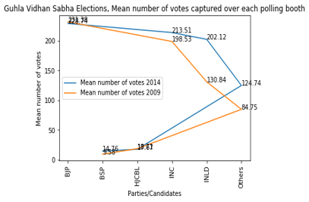
A low standard deviation indicates that the data points tend to be close to the mean of the set, while a high standard deviation indicates that the data points are spread out over a wider range of values. BJP and INC in 2014, 2009 has an exceptionally high standard deviation while BSP and HJCBL have low standard deviation comparatively. Rest have intermediate standard deviation in between 100-150 with INLD in 2014 having high standard deviation.

Slide 11
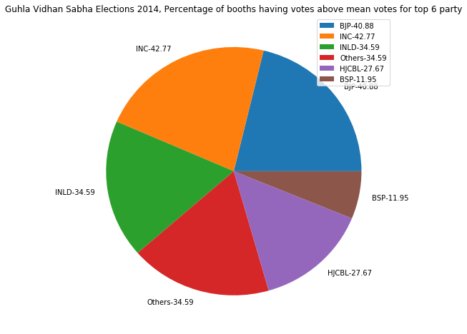
BJP and INC in 2014 have an exceptionally high number of booths above mean votes. Others and HJCBL also secured 34.59% of votes above mean. This shows that analysis is similar to votes won by each party . While BSP got lowest number of booths, equal to 11.95%.

Slide 12
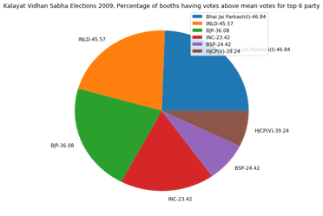
INLD and INC in 2014 have an exceptionally high number of booths above mean votes. Bhai Jai Prakash leads with 46.84% of booths. BJP and HJCBL also secured around 36% of votes above mean. This shows that analysis is similar to votes won by each party . While BSP got lowest number of booths, equal to 11%.

Slide 13
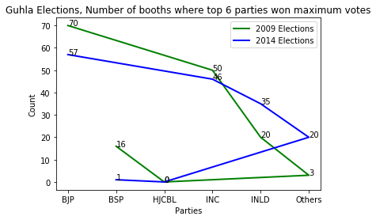
BJP leads and INC is on second each year showing their fixed voter base in the constituency. The number varies a lot for INLD and BSP showing their floating voters are substantial in numbers.

Slide 14
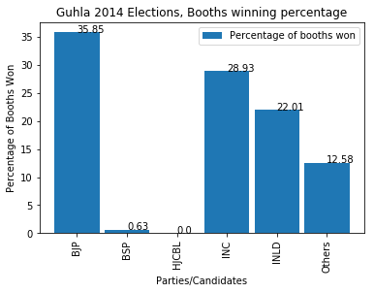
BJP in 2014 have an exceptionally high number of booths above mean votes. INLD and INC finish closely with around 28 Others and HJCBL also secured 34.59% of votes above and 22 % of boothsin which they won .This shows that analysis is similar to votes won by each party . While BSP got lowest number of booths, equal to 0.63% and HJCBL, none showing that they don'y have strong voter's base..

Slide 15
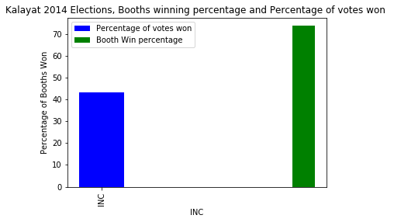
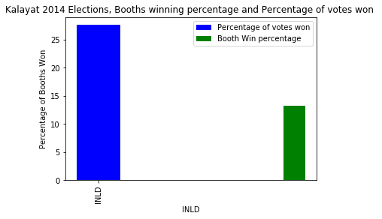
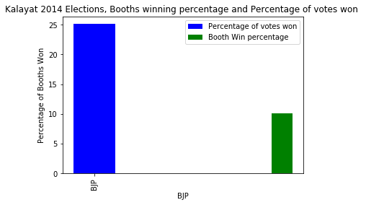
INC won highest number of booths as well as their booth win percentage is very high but INLD even though got large vote percentage could no secure lots of booths in terms of winning. BJP also got more vote percentage but less booth win percentage. This shows that INC has strong voter's base.

Slide 16
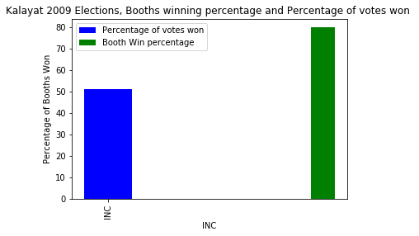
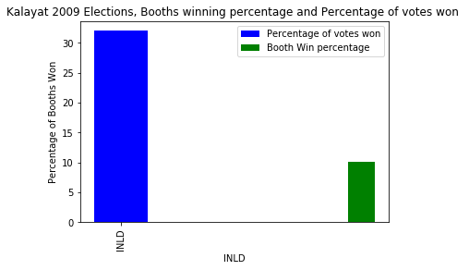
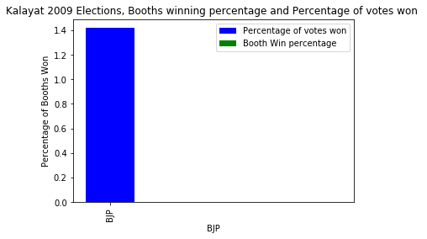
INC won highest number of booths as well as their booth win percentage is very high but INLD even though got large vote percentage could no secure lots of booths in terms of winning. BJP also got more vote percentage but zero booth win percentage. This shows that INC has strong voter's base.

Slide 17
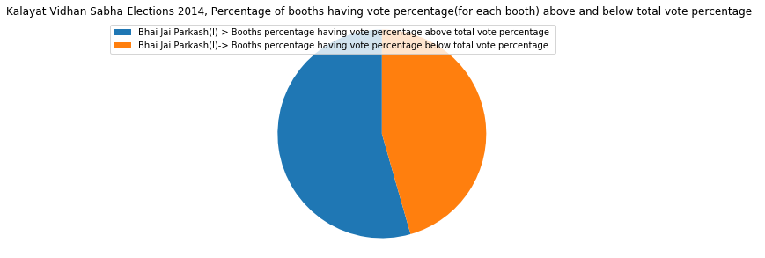
Bhai Jai Prakash won the elections which can be inferred from this graph as he has more than 50 % of booths in which he secured votes above his average votes per booth. But the number of booths in which he secured votes below his average votes per booth is also very high

Slide 18
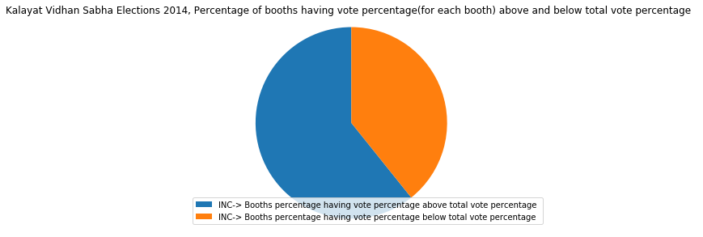
INC finished the elections on high which can be inferred from this graph as he has more than 50 % of booths in which he secured votes above his average votes per booth. Also the number of booths in which they secured votes below average votes per booth is also very low showing strong voter's base.

Slide 19
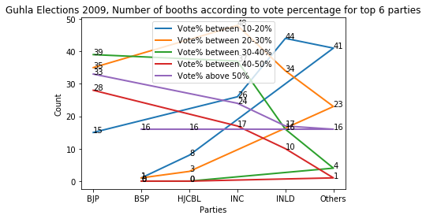
Most of the parties have won 50 % of votes in about 16 booths showing consistency in how people have voted. The only difference is in 10-20% of votes which can make parties win or lose

Slide 20
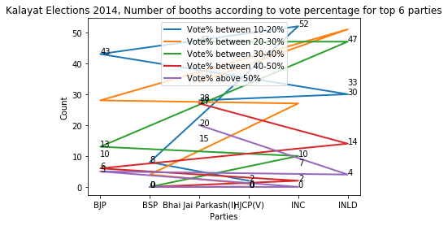
Most of the parties have won 50 % of votes in about 0-4 booths showing consistency in how people have voted with only exception of Bhai Jai Prakash winning more than 50% of votes on about 20 booths. The only difference is in 10-20% of votes which can make parties/candidates win or lose.

Slide 21
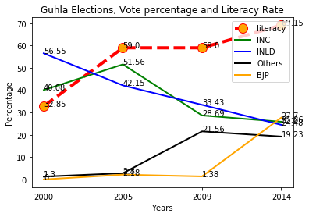
The vote percentage is becoming clustered as years increases, showing that now parties cannot secure votes on old ways of caste bias and leader's impression so easily. The effect can be seen clearly as literacy rate is increasing over the years and people are becoming more aware and now vote with their clear understanding.

Slide 22
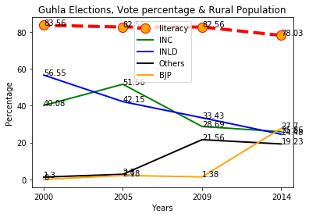
The vote percentage is becoming clustered as years increases, showing that now parties cannot secure votes on old ways of caste bias and leader's impression so easily. There is not so big effect of Rural Population as it is not changing rapidly over the years.

Slide 23
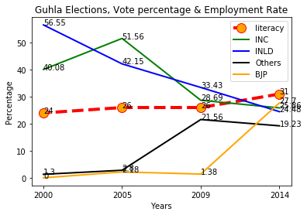
The vote percentage is becoming clustered as years increases, showing that now parties cannot secure votes on old ways of caste bias and leader's impression so easily. But there is very little effect of employment rate

Slide 24
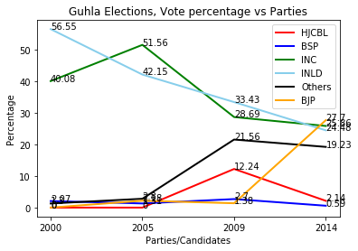
The vote percentage is becoming clustered as years increases, showing that now parties cannot secure votes on old ways of caste bias and leader's impression so easily.

Slide 25
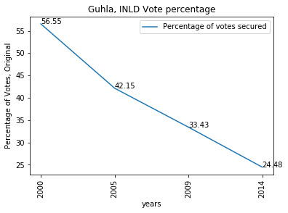
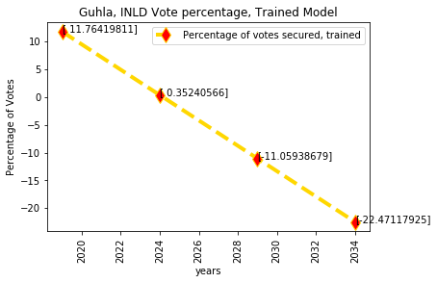
INLD vote percentage and trained model as per Linear Regression. Because of lack of data the model could not be trained properly

Slide 26
Bibliography
STATISTICAL REPORT ON GENERAL ELECTION, 2014 TO THE LEGISLATIVE ASSEMBLY
STATISTICAL REPORT ON GENERAL ELECTION, 2009 TO THE LEGISLATIVE ASSEMBLY
eci.nic.in/eci_main/StatisticalReports/SE_2005/StatisticalReports_HR_2005.pdf
eci.nic.in/eci_main/StatisticalReports/SE_2000/StatisticalReports_HR_2000.pdf
http://eci.nic.in/eci/eci.html
http://ceoharyana.nic.in/
https://www.mapsofindia.com/assemblypolls/haryana/
https://www.wikipedia.org/
https://www.census2011.co.in/census/state/districtlist/haryana.html

Slide 27
Developed Using
Language: Python
Tools: Anaconda, Jupyter Notebook, IDLE, Adobe Acrobat
Library: Pandas, Numpy, Matplotlib, Scikit- Learn
API: For Data Wrangling- 'pdftables-api'

Slide 28
Thank You!!
By Pranjal Rastogi

